Slide 1
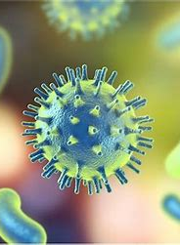
Introduction to Disease
GTHBY Human Biology

Slide 2
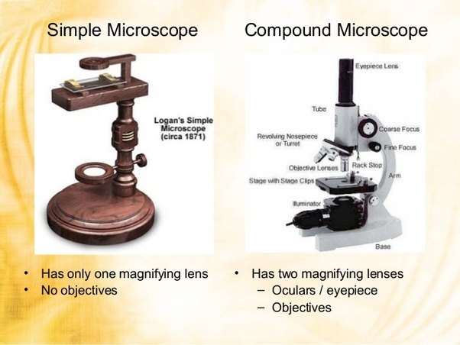
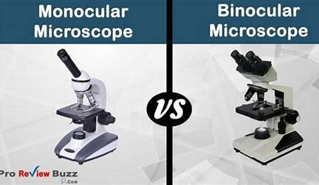
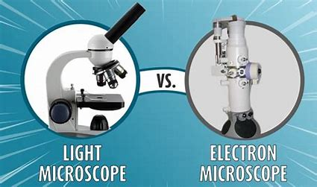
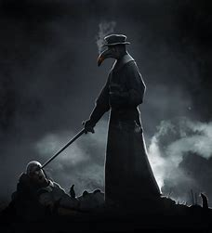
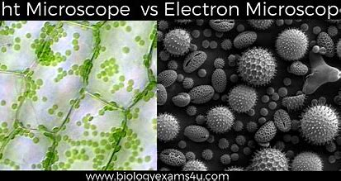
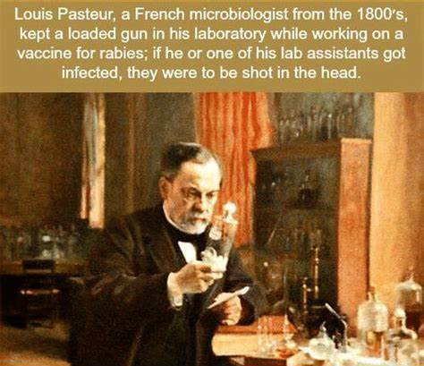
Review
What is the difference between a simple microscope and a compound microscope?
What is miasma?
Name a historical disease thought to be associated with miasma.
What process is named after Louis Pasteur, and how does it work?
What is a microorganism?

Slide 3
Learning Intentions
Types of pathogens and the diseases they cause

Slide 4
Success Criteria
List four types of microorganisms that can cause diseases.
Compare the size of these microorganisms (smallest to largest)
Give one example of a disease caused by each

Slide 5
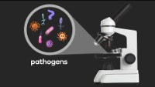

Slide 6
Questions
What is a pathogen?
Name three diseases that are caused by pathogens (microorganisms).
What causes influenza?
Are all bacteria bad for you? Explain.
Are viruses living or non-living? Do they still count as microorganisms?

Slide 7


Slide 8
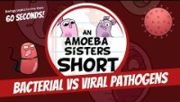

Slide 9
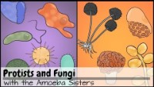

Slide 10
Success Criteria
List four types of microorganisms that can cause diseases.
Compare the size of these microorganisms (smallest to largest)
Give one example of a disease caused by each

